Slide 1
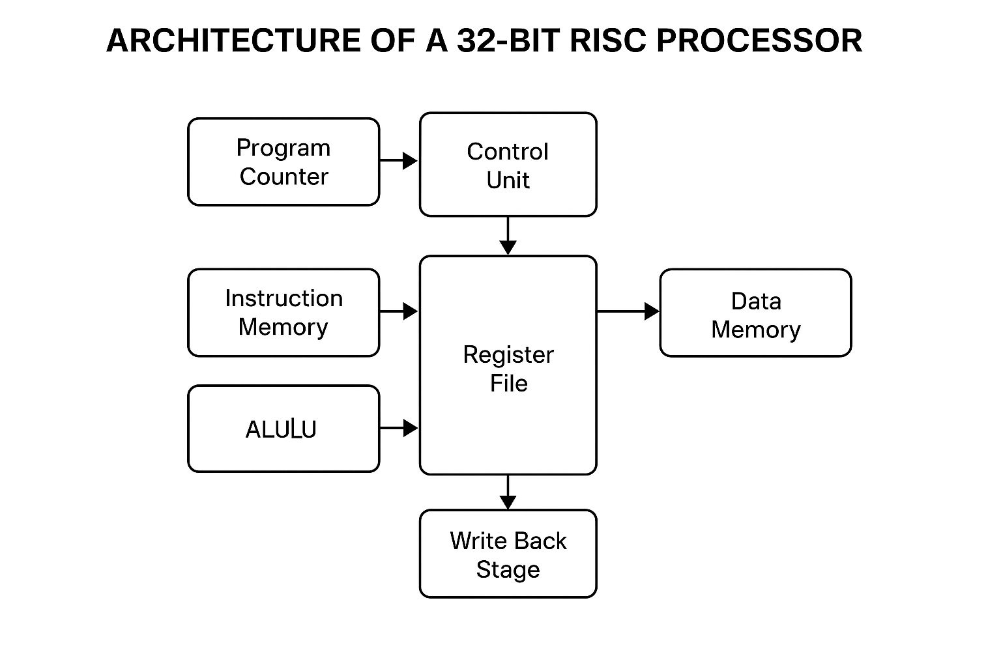
BLOCK DIAGRAM

